Slide 1
Lesson 1: Adding and Subtracting Decimals
First Nine Weeks
TOPIC I: Operations with Whole Numbers, Fractions and Decimals
NS 2.3
6

Slide 2
OBJECTIVE- I will be able to:
Add and subtract decimals fluently using the standard algorithm
VOCABULARY
addends
sum
difference
Essential Question-
How do you find the sum or difference of decimals?

Slide 3
Sums and Differences with Decimals
Find the sum or difference.
2.2 + 3.579 + 14 =
Find the sum or difference.
16 .25 – 3.285 =
0 0
 |  |  | 1 | 6 | 2 | 5
 |  | - |  | 3 | 2 | 8 | 5
 |  |  |  | 2 | 2
 |  |  |  | 3 | 5 | 7 | 9
 | + |  | 1 | 4
0
0 0 0
1 2 9 6 5
1 9 7 7 9
Let’s review:
I Do
Notes:
Click on video. Skip advertisement.

Slide 4
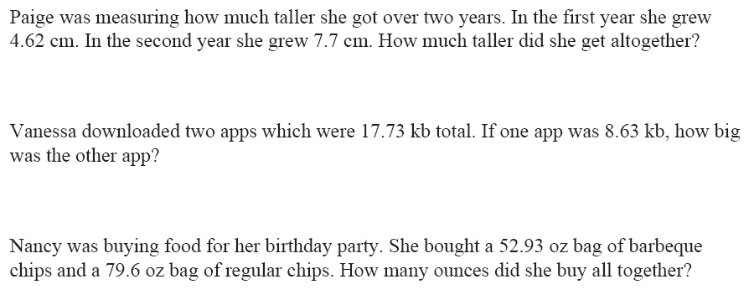
Find the sum or difference.
We Do

Slide 5
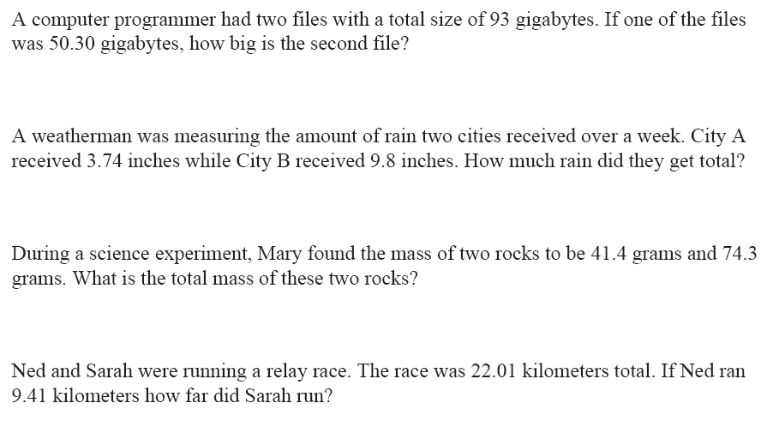
Find the sum or difference.
You Do

